Slide 1
Python Data profiling and excel comparison
By maz

Slide 2

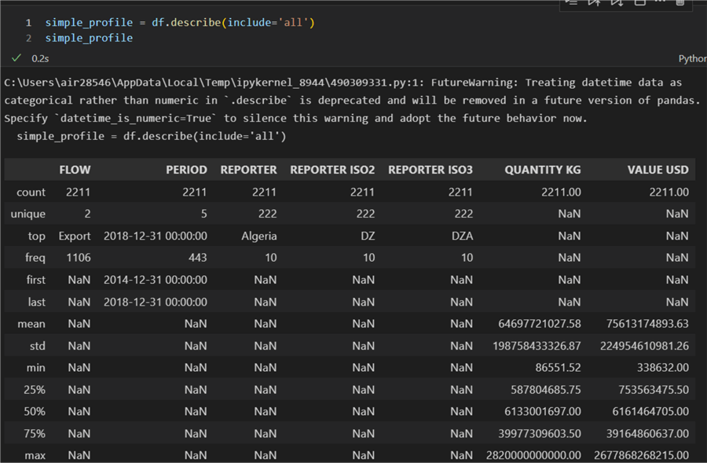
Data profiling
Data profiling is the process of looking at data to determine its quality, organisation, and content. It is a crucial step in the processing of the data and aids in identifying any problems that must be fixed before the data can be used for analysis. The computer language Python is effective and can be used for data profiling. The capacity to read and write data from many sources, support for statistical analysis, and the ability to edit and visualise data are just a few of the built-in capabilities that make it useful for data profiling. In this essay, we will examine some of Python's built-in features that help with data profiling and describe how Python might be utilised for this purpose.

Slide 3


Pythons data profiling
Python is a well-liked programming language because of its adaptability and simplicity. It is simple to read and write data from many different sources, including databases, text files, spreadsheets, web services, etc., thanks to the variety of libraries that are readily available. Because we can rapidly access the relevant data from various sources without having to manually enter it into our application, it is perfect for data profiling. Python also has statistical analysis capabilities, allowing us to quickly spot patterns or trends in our dataset. This can assist us in locating any potential problems with our dataset, such as outliers or missing values, that must be fixed before conducting more research.

Slide 4
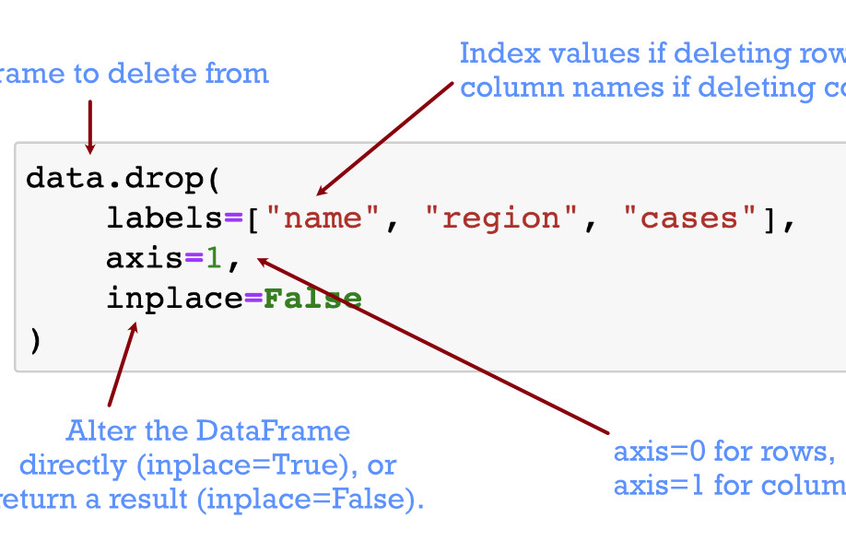
Removing column or rows in python
Python also offers strong capabilities for altering and displaying data, which helps speed up the process of gaining insights into our dataset compared to alternative approaches like manual inspection or spreadsheet programmes. For instance, we may make graphs or charts with the Python matplotlib module that enable us to rapidly spot any patterns or trends in our dataset. Additionally, we may modify our dataset using Python's pandas package by removing unnecessary rows or columns or by running calculations on particular columns. This makes it possible for us to swiftly spot any potential problems with our dataset, such as inaccurate or missing numbers, which must be fixed before further analysis can be done.

Slide 5
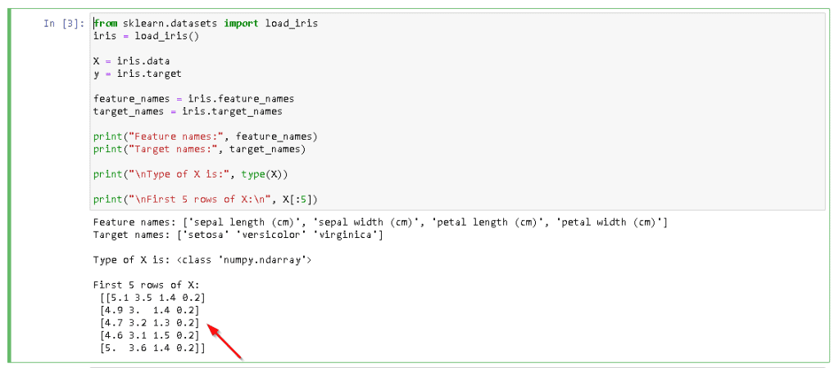
Python's scikit-learn module
Finally, Python offers strong capabilities for automating the data profiling process. For automated feature selection and model construction tasks like clustering or classification, for instance, we can utilise Python's scikit-learn module, which offers a variety of machine learning methods. This spares us from having to manually analyse each row or column to find any potential problems with our dataset. Furthermore, we can employ Python's numpy module, which offers functions for carrying out numerical operations on datasets, such as computing summary statistics (for example, mean) or running correlation analyses between variables (e.g., Pearson correlation). By doing this, we can instantly spot any possible problems with our dataset without having to manually check each row or column.

Slide 6
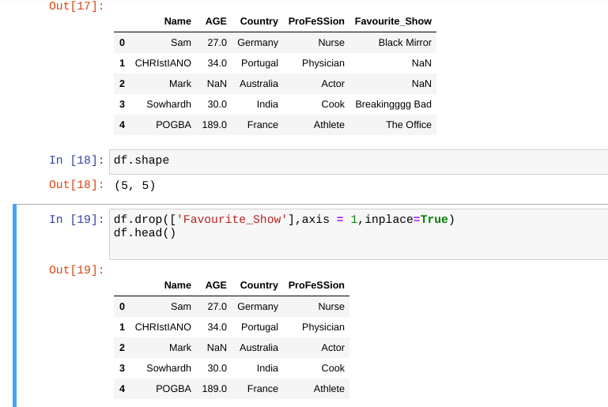
Data cleaning in python
As a result of its many built-in features that help with this process, such as its ability to read from and write to a variety of sources, support for statistical analysis, ability to manipulate and visualise datasets, and automation capabilities via machine learning algorithms/numerical operations functions, Python is a great tool for performing data profiling tasks. We can make sure that our datasets are clean and prepared for further analysis before they are used in production systems by properly utilising these aspects during the data preparation process.

Slide 7
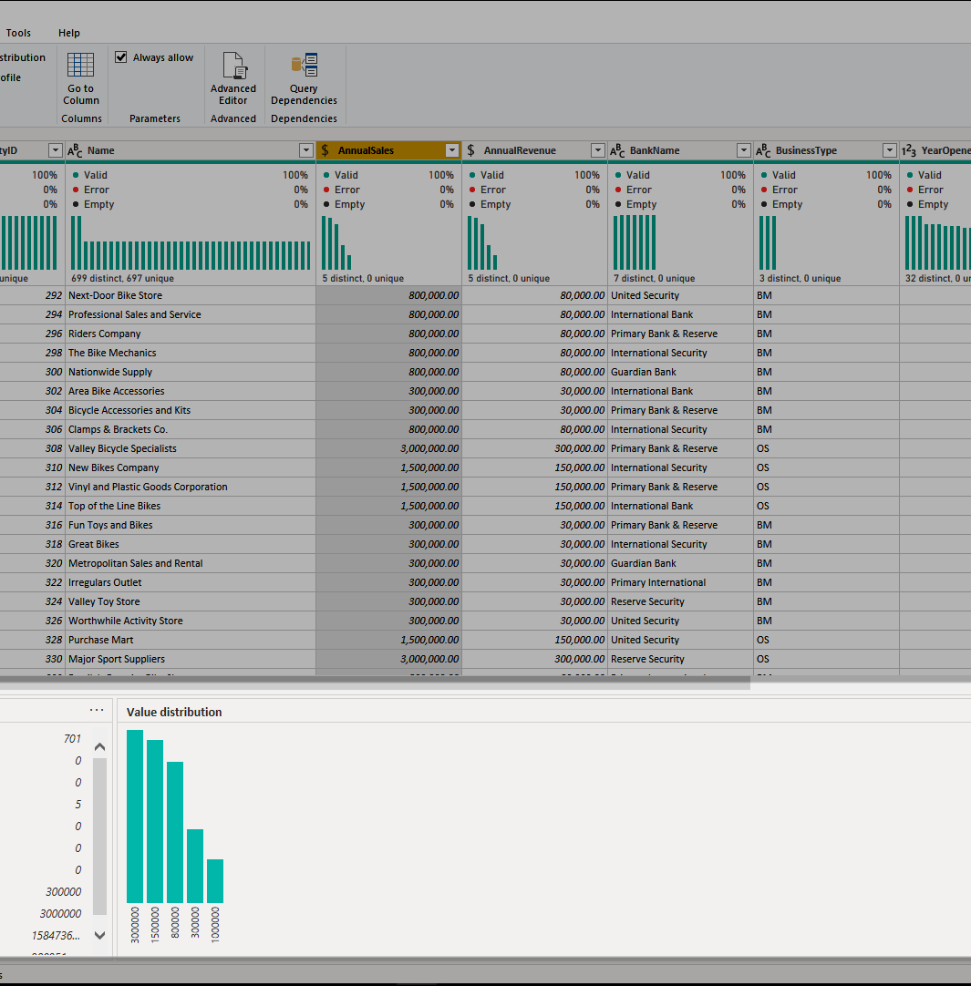
Data profiling with Microsoft excel
Due to its built-in capabilities that support data profiling and its capacity to analyse huge datasets fast, Microsoft Excel is a potent tool for data profiling. The built-in capabilities of Microsoft Excel that help with data profiling will be covered in this essay.

Slide 8
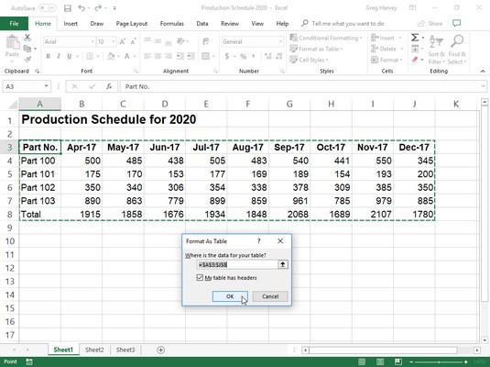
comprehend the dataset's structure in excel
The first step in data profiling is to comprehend the dataset's structure. This includes specifying the quantity, names, and kinds of the columns (e.g., numeric, text, date). There are a number of features in Microsoft Excel that can be useful for this purpose. Users can rapidly turn a dataset into a table with column headings and row labels using the "Format as Table" tool. This makes it simpler to quickly recognise the types of columns. Additionally, by highlighting distinct column types in different colours, the "Data Kinds" functionality enables users to readily identify column types (e.g., numeric columns are highlighted in green).

Slide 9

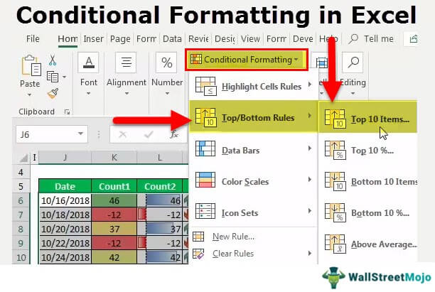
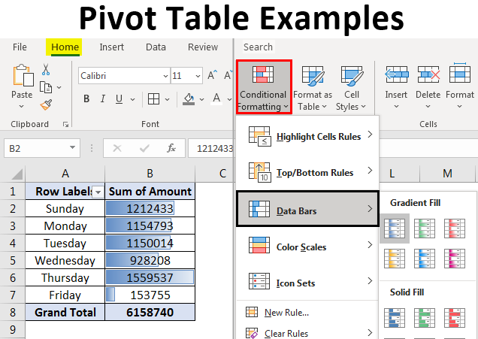
Conditional formatting and pivot tables in excel
Understanding the dataset's content is crucial after the structure of the dataset has been determined. The dataset's missing values and outliers, as well as any patterns or trends that could be present, are all part of this process. Multiple functions in Microsoft Excel are available to assist with this task as well. Users can readily identify missing values by using the "Conditional Formatting" function to highlight them in various colours (e.g., red for missing values). Additionally, by producing data summaries based on certain criteria, the "PivotTable" function enables users to easily analyse massive datasets (e.g., summing up all sales figures for each month). This can be used to spot outliers that might be present outside of any patterns or trends in the dataset as well.

Slide 10

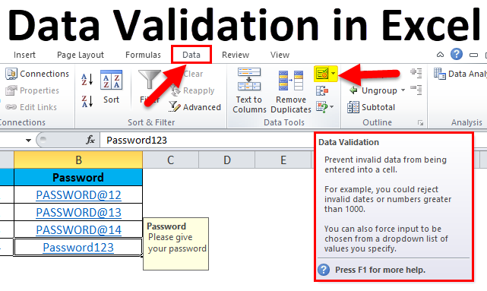
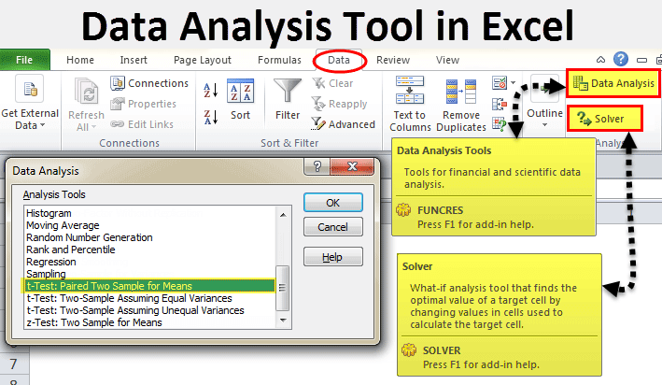
Data validation and data analysis function in excel
Finally, before using a dataset for analysis or reporting purposes, it is critical to determine its quality. A dataset's accuracy and dependability are measured using a variety of measures, including completeness, accuracy, consistency, timeliness, etc. There are a number of features in Microsoft Excel that can be used to evaluate the quality of data, including "Data Validation," which enables users to specify criteria for validating cell entries (for example, only allowing numbers between 1 and 10), and "Data Analysis," which enables users to run statistical analyses on datasets (e.g., testing for normality). Before using a dataset for analysis or reporting, users can easily determine whether it satisfies a set of quality requirements thanks to these characteristics.

Slide 11

Conclusion on excel for data profiling
In conclusion, Microsoft Excel's built-in capabilities that aid in data profiling and its capacity to quickly evaluate massive datasets make it a really potent tool. Before using a dataset for analysis or reporting, it can be used to comprehend both the structure and content of the dataset as well as evaluate its quality. Microsoft Excel has all the tools required for successful data profiling projects, and data profiling is a crucial stage in any data preparation process.

Slide 12
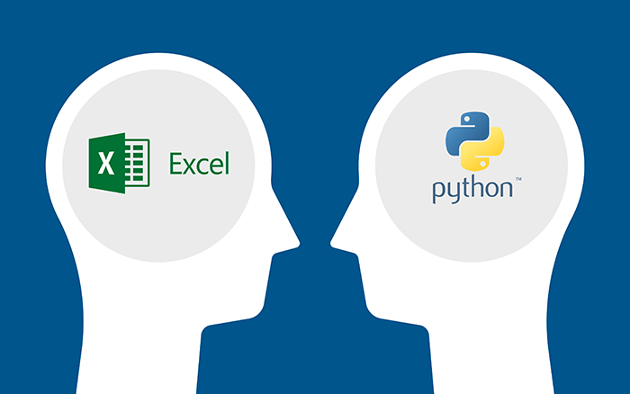
Data profiling comparison with excel & python
Data profiling is the process of looking at data to determine its quality, organisation, and content. Before the data is used for analysis or other reasons, it is important to detect any potential problems with it as part of the data preparation process. Using specialist software tools or manually profiling data is also options. Python and Microsoft Excel are two well-liked programmes that can be used for data profiling. In addition to discussing how data can be profiled using each tool, I will compare and contrast the features of Microsoft Excel and Python that aid in data profiling.

Slide 13


Data profiling comparison with excel & python (continued)
Data profiling is the process of looking at data to determine its quality, organisation, and content. Before the data is used for analysis or other reasons, it is important to detect any potential problems with it as part of the data preparation process. Using specialist software tools or manually profiling data is also options. Python and Microsoft Excel are two well-liked programmes that can be used for data profiling. In addition to discussing how data can be profiled using each tool, I will compare and contrast the features of Microsoft Excel and Python that aid in data profiling.

Slide 14

Data profiling comparison with excel & python (continued)
Microsoft Excel is a spreadsheet programme that was created by Microsoft and is frequently used for manipulating and analysing data. Its many integrated features make it the perfect tool for data profiling. The "Data Analysis" tool in Excel, for instance, enables users to swiftly summarise enormous datasets by producing pivot tables, charts, and graphs. Additionally, by establishing criteria to evaluate the correctness of their data, Excel's "Data Validation" tool enables users to quickly spot mistakes in their datasets. Finally, users may easily clean up their datasets using Excel's "Data Cleaning" feature by eliminating duplicates, fixing errors, and adding missing numbers.

Slide 15

Pythons libaries
Because of its adaptability and usability, Python, a high-level programming language created by Guido van Rossum in 1991, has grown in popularity for data analysis and manipulation. Python is a great tool for data profiling because it offers a number of other built-in functions. For instance, the "Pandas" module in Python offers effective methods for summarising big datasets into pivot tables, charts, and graphs. Furthermore, the Python "NumPy" library offers strong tools for ensuring the accuracy of datasets, including algorithms for looking for outliers and missing values. Last but not least, the "SciPy" module in Python offers robust routines for cleaning up datasets, such as eliminating duplicates or fixing mistakes.

Slide 16

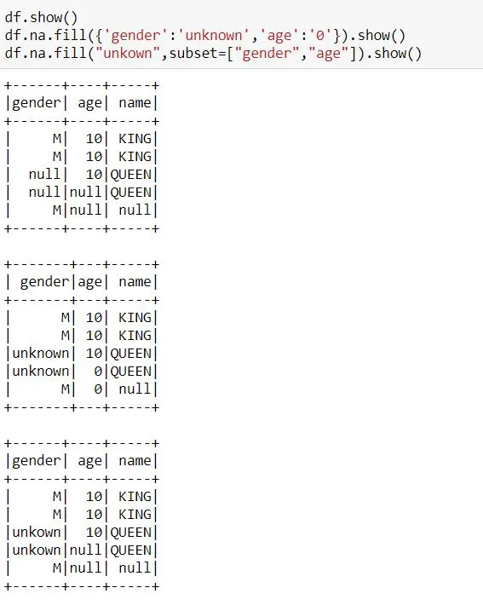
Data profiling comparison with excel & python (continued)
There are several significant variations between the two programmes that should be taken into account when choosing which one to utilise when undertaking data profiling with either Microsoft Excel or Python. For instance, Excel does not have any built-in functions for checking the accuracy of datasets like Python provides with NumPy or SciPy libraries, despite the fact that both tools allow users to quickly summarise large datasets using pivot tables and charts/graphs. Additionally, Excel has built-in methods expressly created for this goal, unlike Python, which has Pandas library functions like drop duplicates() and fillna that allow users to quickly clean up their datasets by removing duplicates, correcting typos/missing values, etc ().

Slide 17

conclusion
Finally, it should be noted that both Python and Microsoft Excel are strong programmes that may be used to great advantage for data profiling tasks like summarising sizable datasets or validating/cleaning up already existing ones. However, there are some significant differences between them that should be taken into account when deciding which one to use depending on the specific task at hand. For example, while Excel offers more features when it comes to summarising large datasets using pivot tables, charts, and graphs, etc., it does not have any built-in functions specifically designed for validating or cleaning up existing ones, like those provided by NumPy/SciPy libraries in Python (Pandas). However, in the end, it will come down to personal preference. For example, if you enjoy dealing with spreadsheets, Microsoft Excel would be a better choice, whereas if you prefer working with code, Python might be a better choice, depending on your particular needs/requirements.

